Slide 1


Speaker: Rishi S.
Clean Code
The Art of Writing Readable and Maintainable Code

Slide 2

Objectives
After this module you will be able to:
Understand and Apply Naming Conventions
Construct Efficient and Clear Constructors
Develop Effective Methods
Implement Robust Exception Handling
Master Class Organization
Adopt a Consistent Code Style
Write and Maintain Effective Comments
Maintain Clean Code

Slide 3

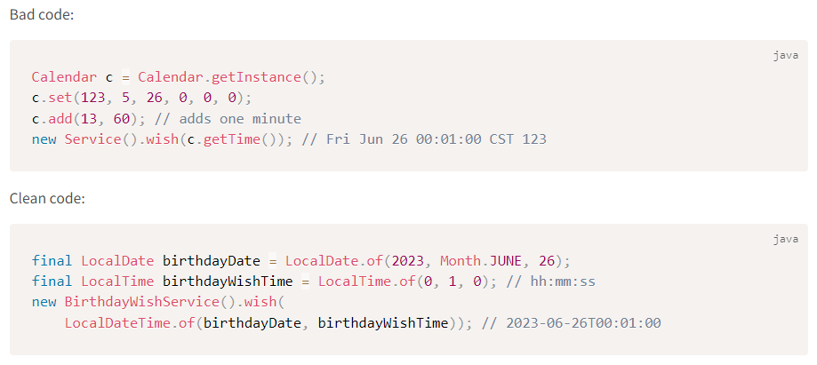
Introduction
What is Clean Code?
Clean Code

Slide 4
Introduction
What is Clean Code?
“The best programs are written so that computing machines can perform them quickly and so that human beings can understand them clearly.” ~ Donald Knuth
“Any fool can write code that a computer can understand. Good programmers write code that humans can understand.” ~ Martin Fowler
“We are constantly reading old code as part of the effort to write new code… Therefore, making it easy to read makes it easier to write.” ~ Robert Martin
“Always code as if the guy who ends up maintaining your code will be a violent psychopath who knows where you live.” ~ John Woods
Clean Code

Slide 5
Introduction
Dirty code consequences
More bugs: as the code is not testable
Decreased productivity: as the code is not maintainable
Overtime AND lower job satisfaction: more time spent on reading or understanding the code and solving production issues rather than writing real good development projects
Clean Code

Slide 6

Good Names
Good Constructors
Good Methods
Good Exceptions
Good Class Organization
Good Code Style
Good Comments
Maintaining Clean Code

Slide 7
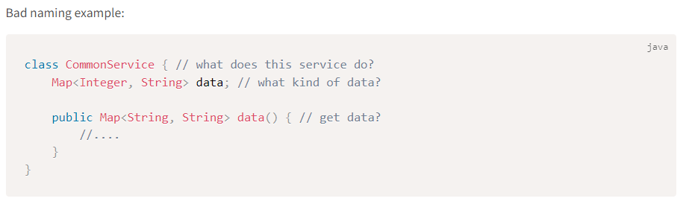
Good Names
Why Good Names?
Following good naming conventions can go a long way in making our code readable and maintainable.
Clean Code

Slide 8
Good Names
Class names
Classes and objects should have noun or noun phrase names.
A class name should NOT be a verb.
For example: Customer, Dog, House, WikiPage, Account, AddressParser, OrderAlgo, EmailSender etc.
It should be specific as well.
Clean Code

Slide 9
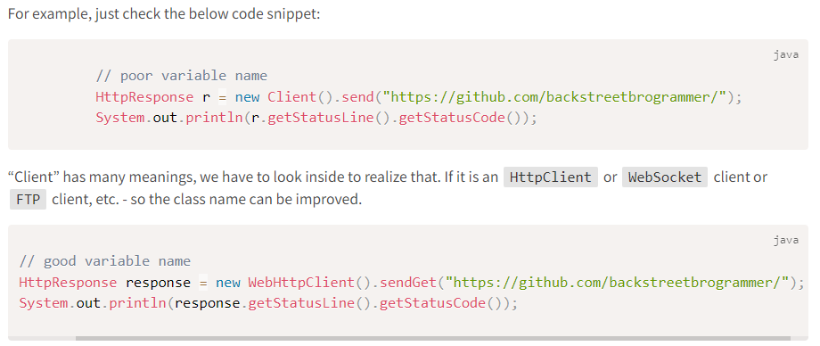
Good Names
Class names
Clean Code

Slide 10
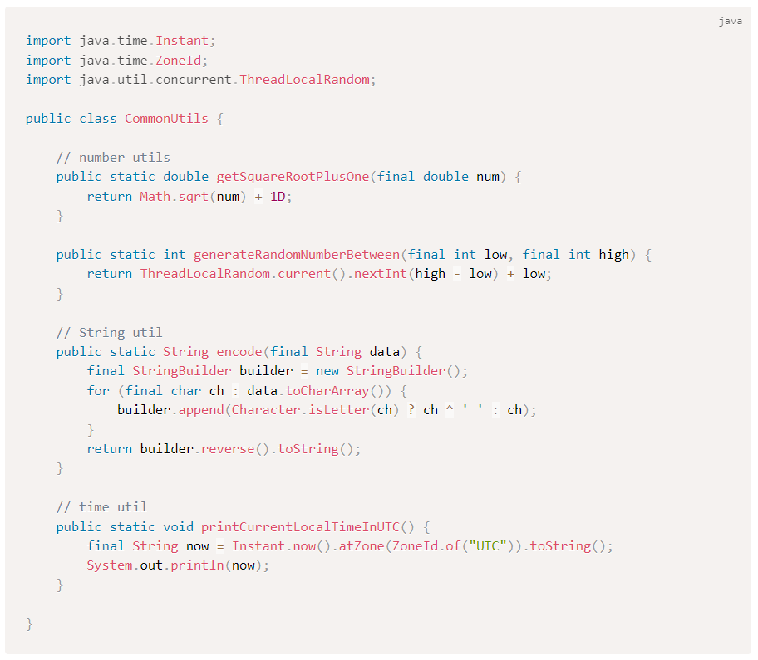
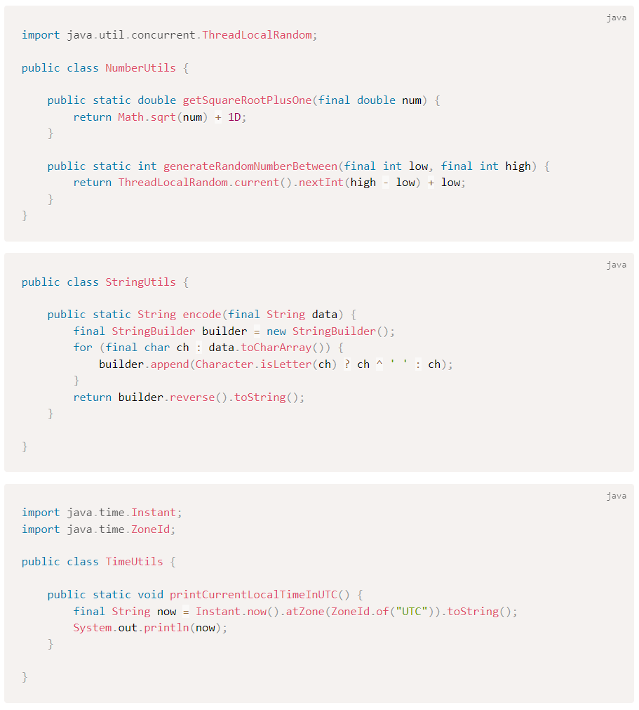
Good Names
Clean Code

Slide 11
Good Names
Class names
To summarize, avoid ending class names as: Coordinator, Manager, Processor, Data, or Info and always be more specific.
Some alternatives are:
Builder
Factory
Container
Writer
Reader
Handler
Clean Code

Slide 12
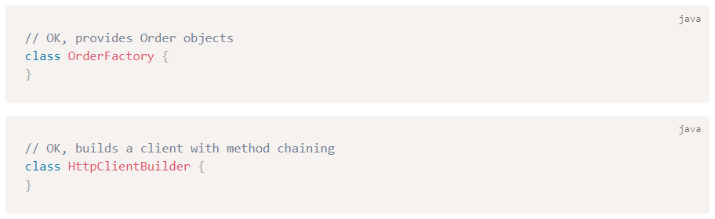
Good Names
Class names
There are quite a few design patterns used for creating objects: Builder, Factory, Singleton, etc.
Thus, we can use these patterns to create class names as:
Clean Code

Slide 13
Good Names
Variable names
Variables in Java capture the state of the object created from a class.
The name of the variable should describe the intent of the variable clearly.
Few guidelines to check:
use camelCase (Java convention)
always specific
never a single letter, except in case of loops like for or foreach
should be only 1-2 words, do NOT use very long variable names
booleans should be prefixed with “is” or “has”: isActive, isInterrupted, hasCompleted, etc.
use ALL_CAPS with underscores for static constants
Clean Code

Slide 14
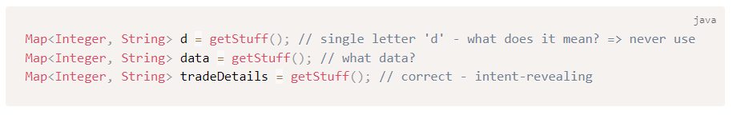
Good Names
Variable names
For Example:
Clean Code

Slide 15
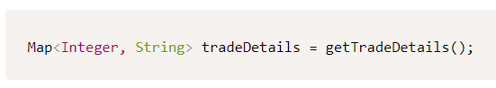
Good Names
Method names
Few guidelines to check:
name should reveal intent
anyone can fully understand functionality from the name
In other words, if we have to look inside the method to understand what it does – the name needs improvement.
Taking the previous code snippet, we can rename the getStuff() method:
Clean Code

Slide 16
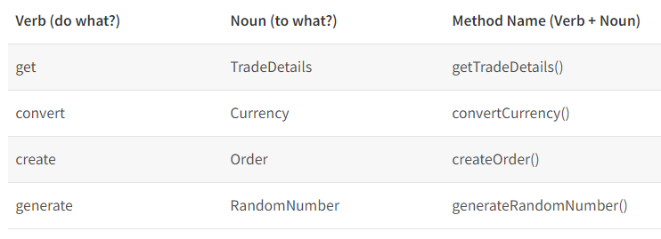
Good Names
Method names
As methods are actions, we can follow these conventions:
Clean Code

Slide 17
Good Names
Method names
Few more checks while defining a method and its name:
avoid abbreviations => getKms(), calculateKgs(), setLbs() - do NOT use this
avoid spelling errors, otherwise, it will be difficult to search in a large project
similar to classes, a method should do only one thing and should only have one reason to change
if a method does MORE than the name says or if it has the name which contains “and”, “or”, “if” => it should be split into smaller methods
Clean Code

Slide 18
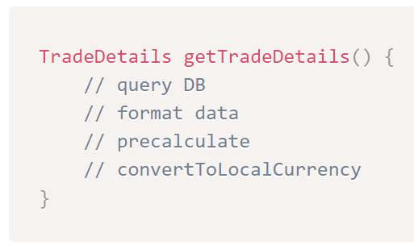
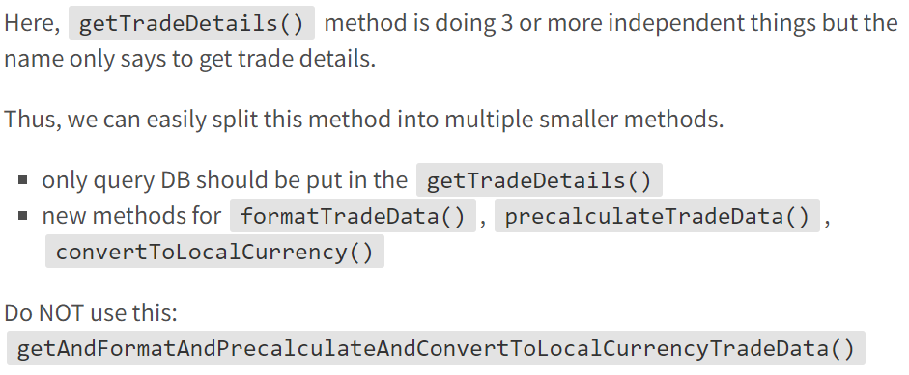
Good Names
Method names
Clean Code

Slide 19
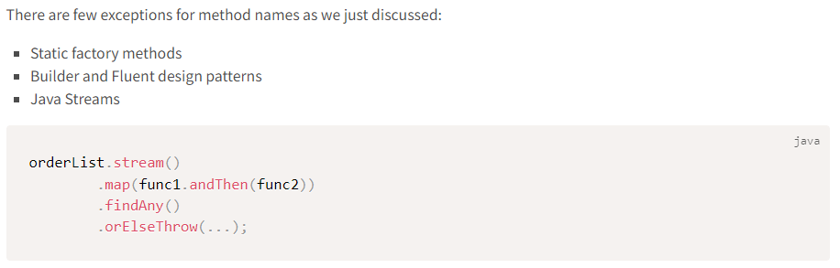
Good Names
Method names
Clean Code

Slide 20
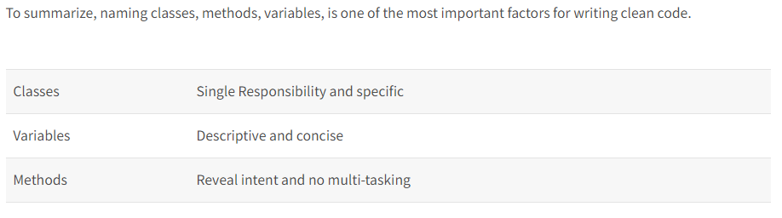
Good Names
Method names
Clean Code

Slide 21
Good Names
Good Constructors
Good Methods
Good Exceptions
Good Class Organization
Good Code Style
Good Comments
Maintaining Clean Code

Slide 22
Good Constructors
Creating Objects in Java
The most common way to create an object in Java is using new operator and call the constructor.
Java constructors have the same name as Class name.
Sometimes it may be difficult to remember which constructor should be called if there are overloaded constructors.
Clean Code

Slide 23
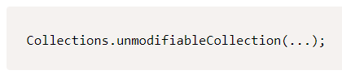
Good Constructors
Static Factory Methods
Thus, we can also have static factory methods instead of constructors with meaningful names to return a new object.
For example: the following static factory method will return an unmodifiable collection object as the name says which is clear and clean.
Clean Code

Slide 24
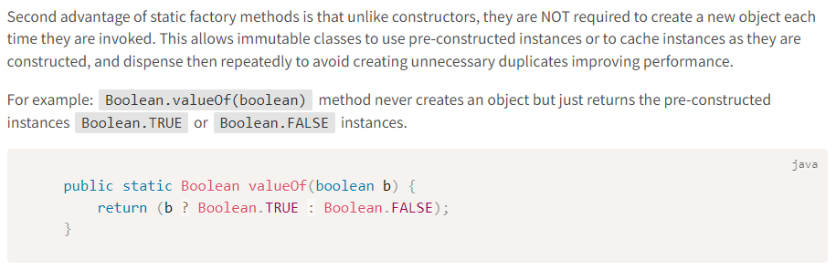
Good Constructors
Static Factory Methods
Clean Code

Slide 25
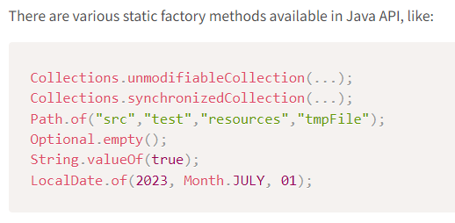
Good Constructors
Static Factory Methods
Clean Code

Slide 26
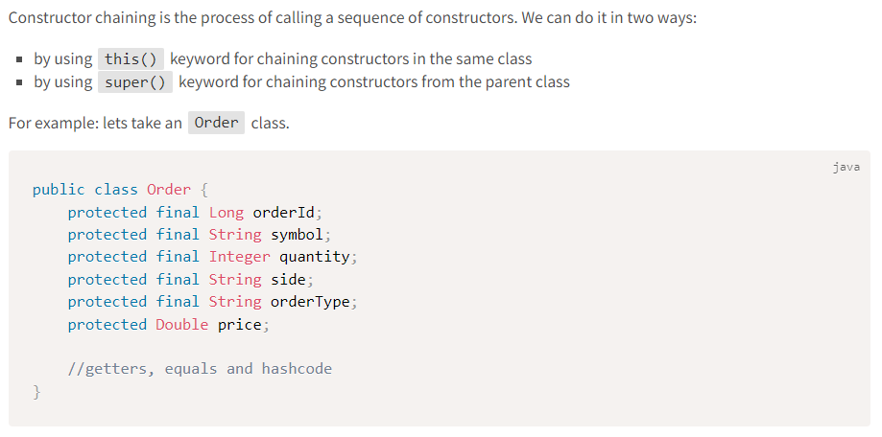
Good Constructors
Constructor Chaining
Clean Code

Slide 27
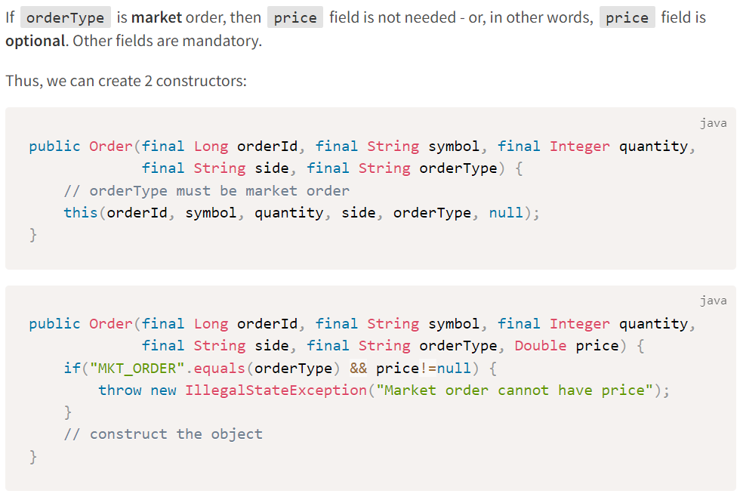
Good Constructors
Constructor Chaining
Using this(), we are not duplicating the code for order type check and all checking is done at one place in the second constructor => this is called DRY (Don’t Repeat Yourself) principle.
Clean Code

Slide 28
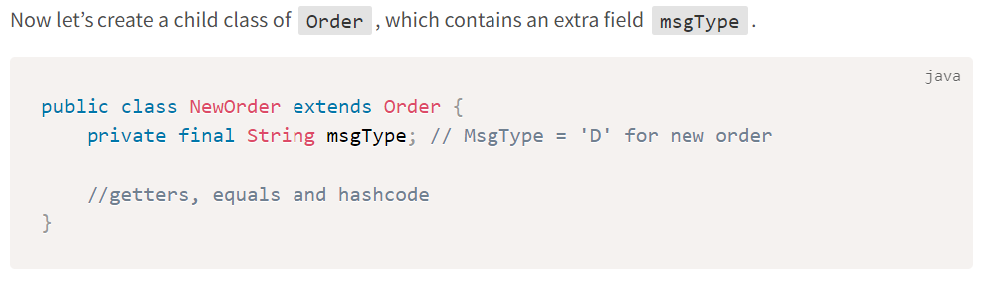
Good Constructors
Constructor Chaining
Clean Code

Slide 29
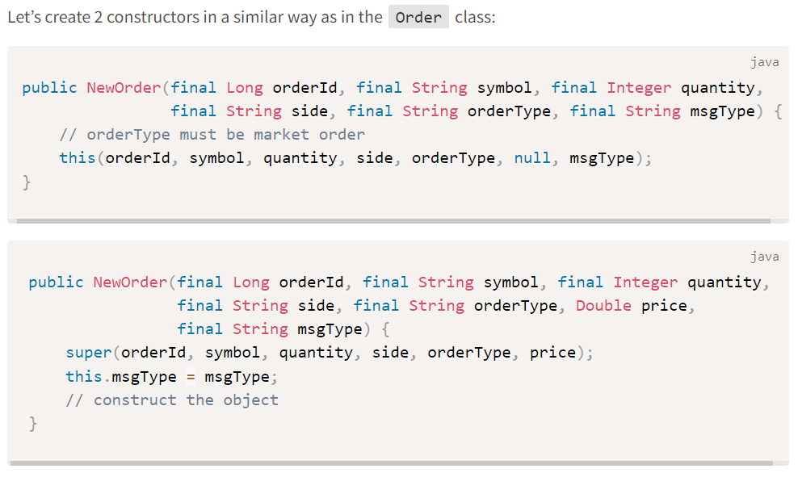
Good Constructors
Constructor Chaining
Chaining constructors makes code more readable.
We don’t have to repeat attribute assignments throughout all constructors.
Instead, we do this in one place.
Clean Code

Slide 30
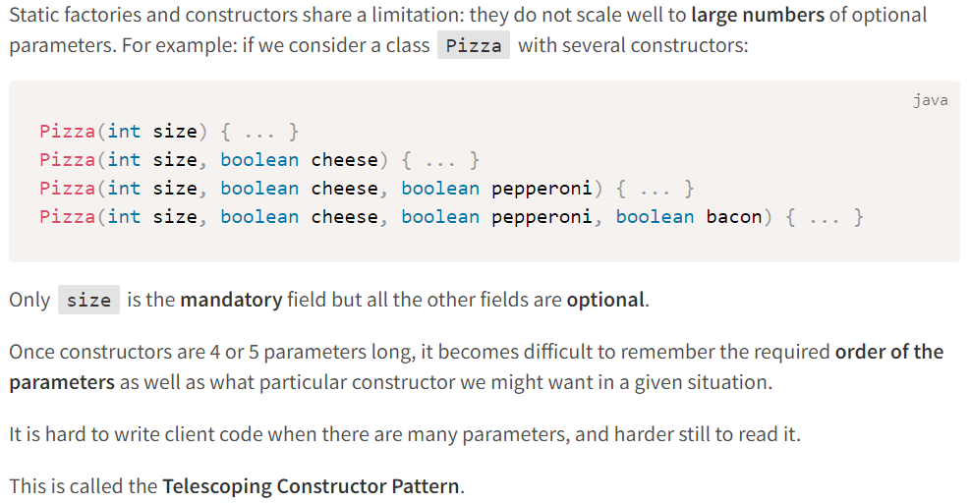
Good Constructors
Constructor Telescoping
Interview Problem 1 (Barclays): Explain Telescoping Constructor Pattern and how to resolve it.
Clean Code

Slide 31
Good Constructors
Builder Pattern
Here comes the Builder pattern to rescue.
Instead of making the desired object directly, the client calls a constructor (or static factory) with all the required parameters and gets a builder object.
Then the client calls setter-like methods on the builder object to set each optional parameter of interest.
Finally, the client calls a parameterless build method to generate the object, which is typically immutable.
The builder is typically a static member class of the class it builds.
Clean Code

Slide 32
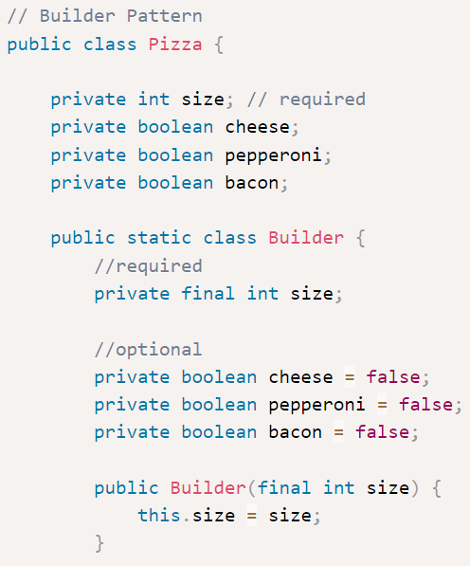
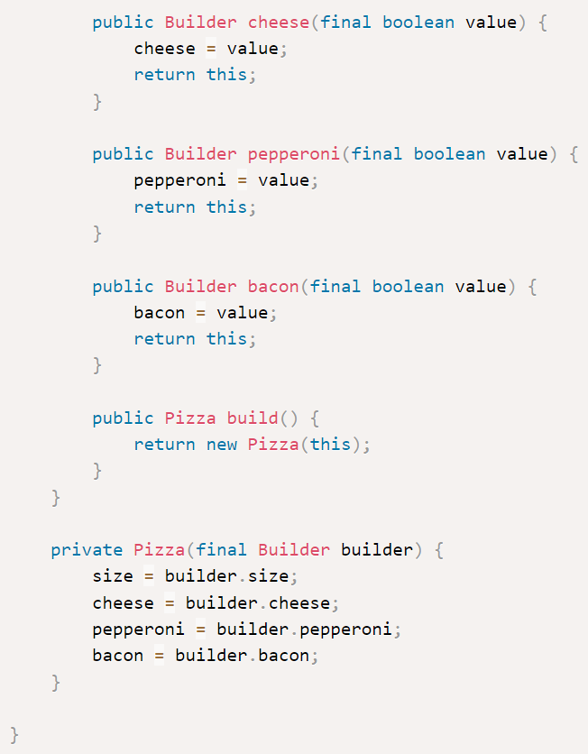
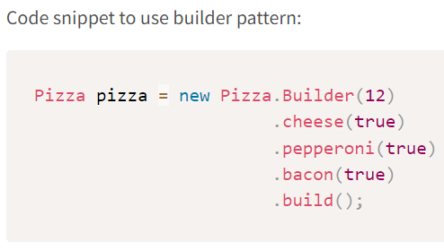
Good Constructors
This client code is easy to write and, more importantly, easy to read.
The Pizza class is immutable, and all parameter default values are in one place.
The builder’s setter methods return the builder itself so that invocations can be chained, resulting in a fluent API.
Clean Code

Slide 33
Good Names
Good Constructors
Good Methods
Good Exceptions
Good Class Organization
Good Code Style
Good Comments
Maintaining Clean Code

Slide 34
Good Methods
What are Good Methods?
Methods should be simple doing only one thing with no complexities.
Often, lower complexity means better code.
Clean Code

Slide 35
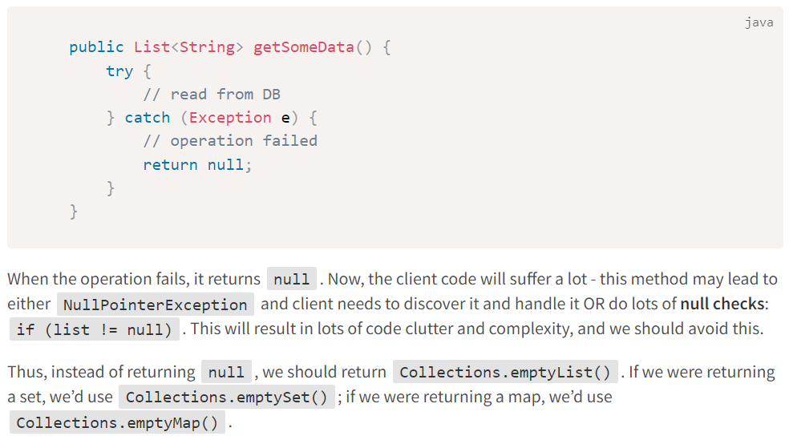
Good Methods
Return empty collections or arrays, not nulls
Clean Code

Slide 36
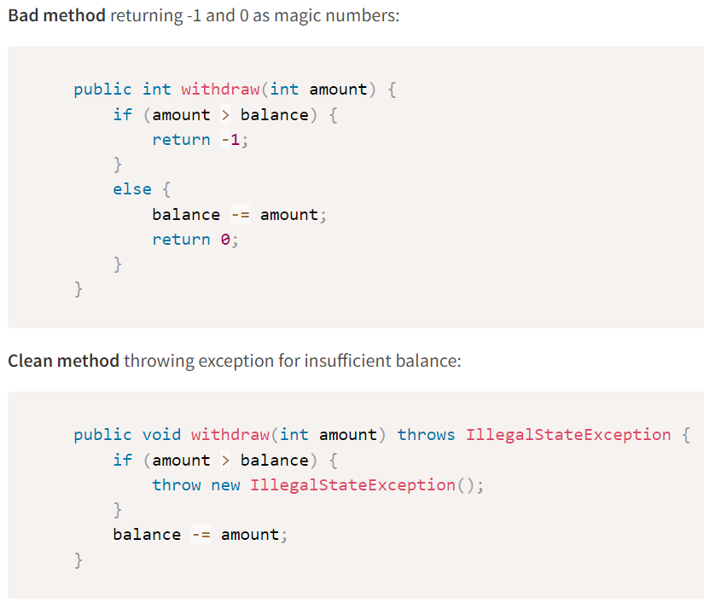
Good Methods
Avoid Magic Numbers
Similar care should be taken to NOT return some magic numbers like -1, 0, 1, etc. making the client code keep guessing what does it mean.
Clean Code

Slide 37
Good Methods
Returning Optionals
Exceptions should be reserved for exceptional conditions. There is another approach to writing methods that may not be able to return a value.
The Optional<T> class represents an immutable container that can hold either a single non-null T reference or nothing at all.
A method that conceptually returns a T but may be unable to do so under certain circumstances can instead be declared to return an Optional<T>.
This allows the method to return an empty result to indicate that it could NOT return a valid result.
An Optional-returning method is more flexible and easier to use than one that throws an exception, and it is less error-prone than one that returns null.
Clean Code

Slide 38
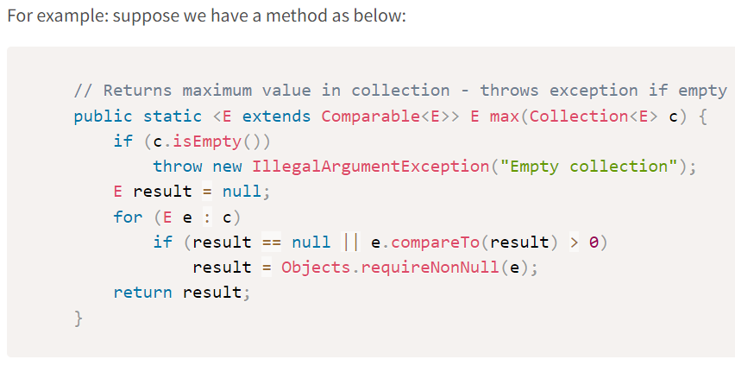
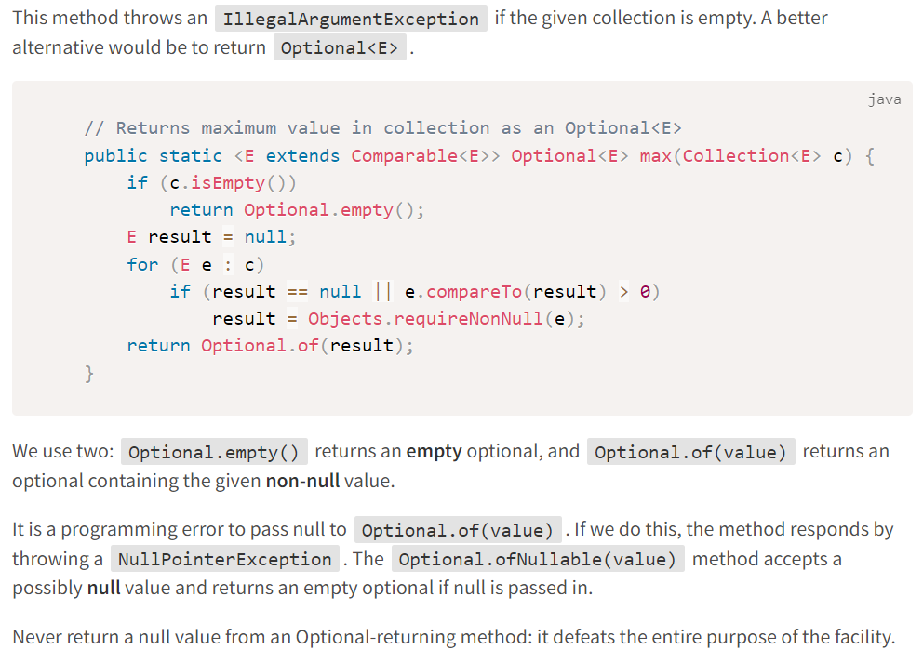
Good Methods
Returning Optionals
Clean Code

Slide 39
Good Methods
Reduce number of arguments to maximum 3
Fewer method arguments are better and clean.
Methods with more than 3 arguments means:
method is doing more than 1 thing - split it
take too many primitive types - wrap it into an object and pass that object instead
takes a boolean flag - split it into 2 methods with each implemented for TRUE and FALSE
Clean Code

Slide 40
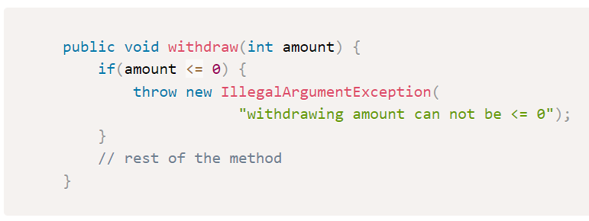
Good Methods
Always validate the method arguments first before writing any method implementation
Before we should write any method implementation, at the very first line => we should validate the method arguments passed. This will help to fail-fast if arguments are invalid.
Clean Code

Slide 41
Good Names
Good Constructors
Good Methods
Good Exceptions
Good Class Organization
Good Code Style
Good Comments
Maintaining Clean Code

Slide 42
Good Exceptions
Why Good Exceptions?
When used to best advantage, exceptions can improve a program’s readability, reliability, and maintainability.
When used improperly, they can have the opposite effect.
Clean Code

Slide 43
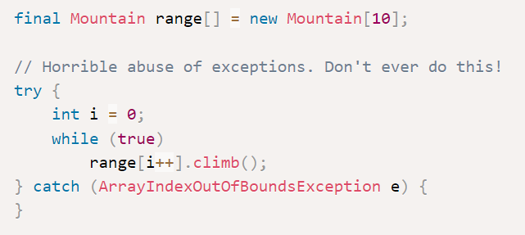
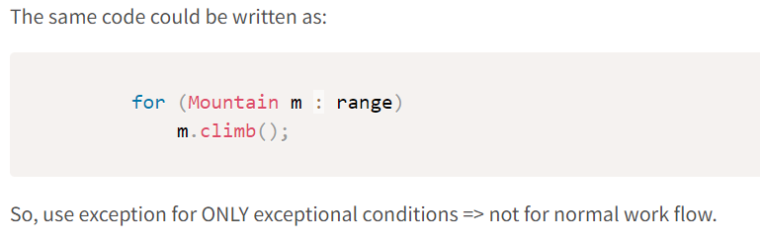
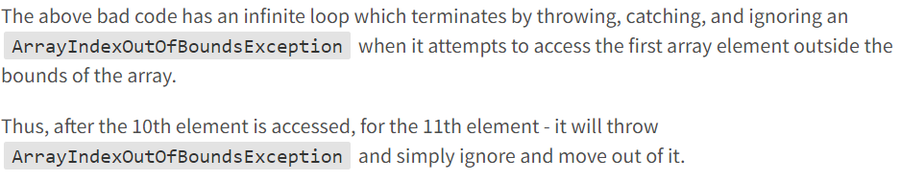
Good Exceptions
Use exception for only exceptional conditions
Clean Code

Slide 44
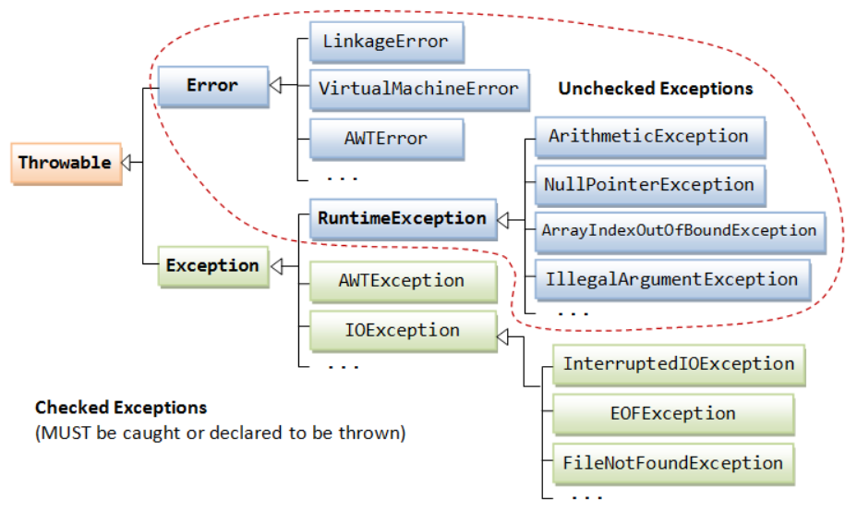
Good Exceptions
Best Practices of Handling Exceptions
Do not catch or handle unchecked exceptions as these are programming errors.
Instead, use checked exceptions for recoverable conditions and runtime exceptions for programming errors.
Clean Code

Slide 45
Good Exceptions
Which Type of Exception To Use?
Java provides 3 kinds of throwables:
Checked exceptions, Runtime exceptions (unchecked), and Errors (unchecked).
The cardinal rule in deciding whether to use a checked or an unchecked exception is this:
Use checked exceptions for conditions from which the caller can reasonably be expected to recover.
Clean Code

Slide 46
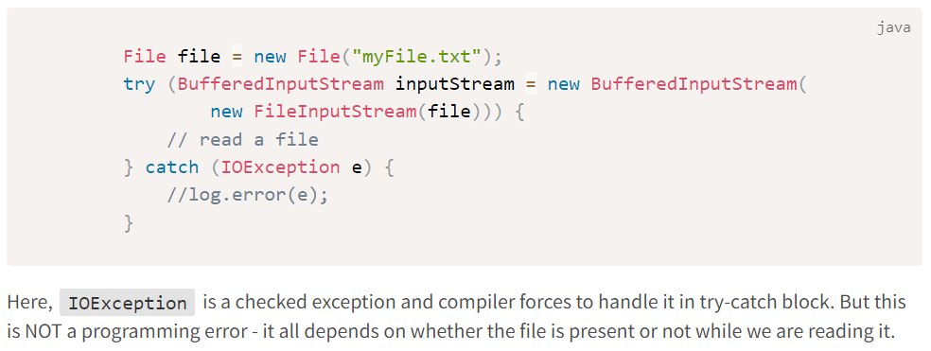
Good Exceptions
Throwing a Checked Exception
By throwing a checked exception, we force the caller to handle the exception in a catch clause or to propagate it outward.
Clean Code

Slide 47
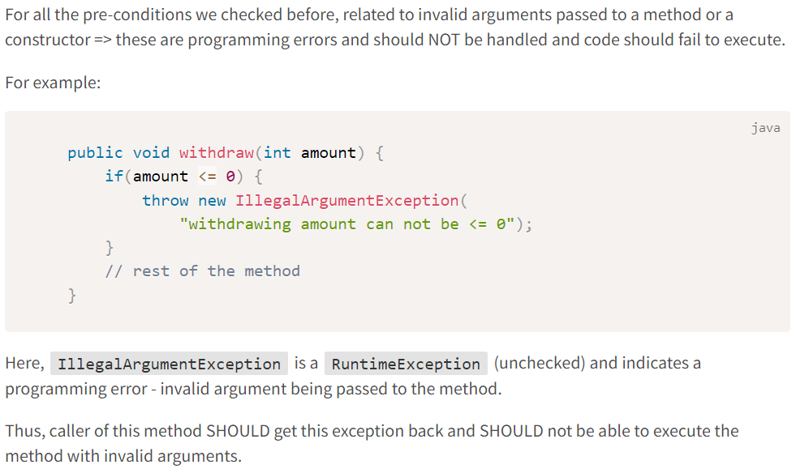
Good Exceptions
Throwing an Unchecked Exception
Clean Code

Slide 48
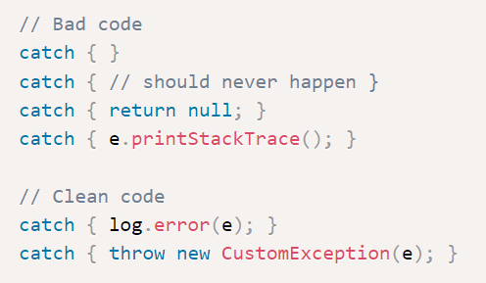
Good Exceptions
Catch block
Catch Block should NOT:
be empty
have only comments
only print stack trace
Catch Block should:
log the error
throw new custom exception
be specific - for ex, don’t use just Exception class => use the specific exception class
Clean Code

Slide 49
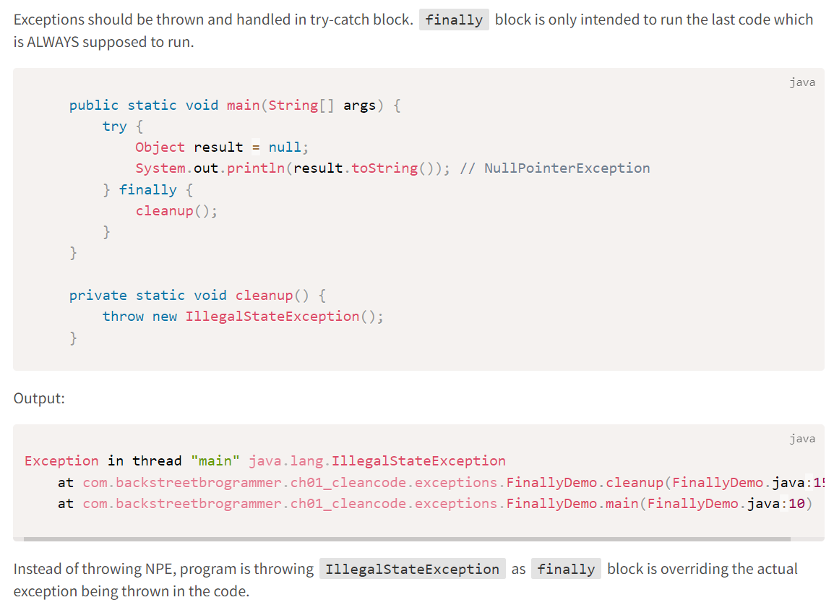
Good Exceptions
Avoid exceptions in finally block
Exceptions should be thrown and handled in try-catch block.
finally block is only intended to run the last code which is ALWAYS supposed to run.
Clean Code

Slide 50
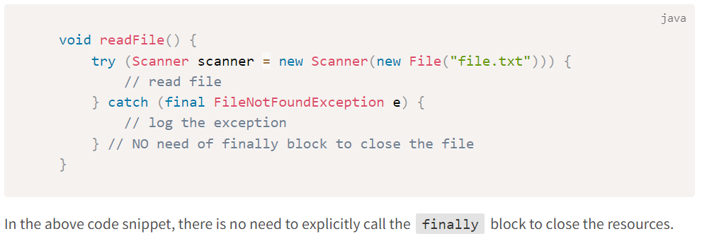
Good Exceptions
Always use try-with-resources, and then we can avoid using finally block
Clean Code

Slide 51
Good Names
Good Constructors
Good Methods
Good Exceptions
Good Class Organization
Good Code Style
Good Comments
Maintaining Clean Code

Slide 52
Good Class Organization
SRP - Single Responsibility Principle
For methods, we learned that it should adhere to SRP => meaning it should only do ONE thing.
However, for classes, the definition of SRP is little different:
if a class does only ONE thing => it may result in a lot of very small classes in the codebase making it fragile and spaghetti-like code
thus, better definition for SRP applied to class is => it should have ONLY one reason to change
Clean Code

Slide 53
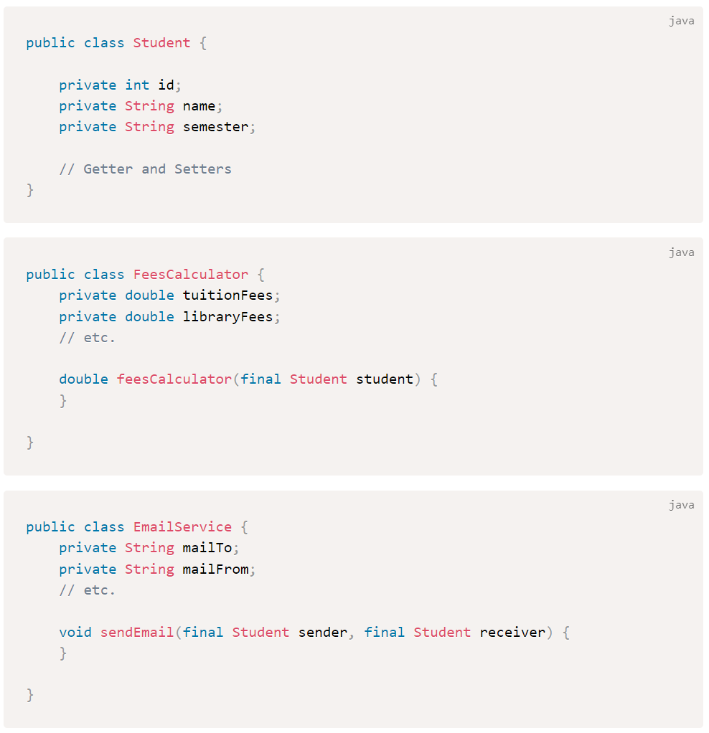
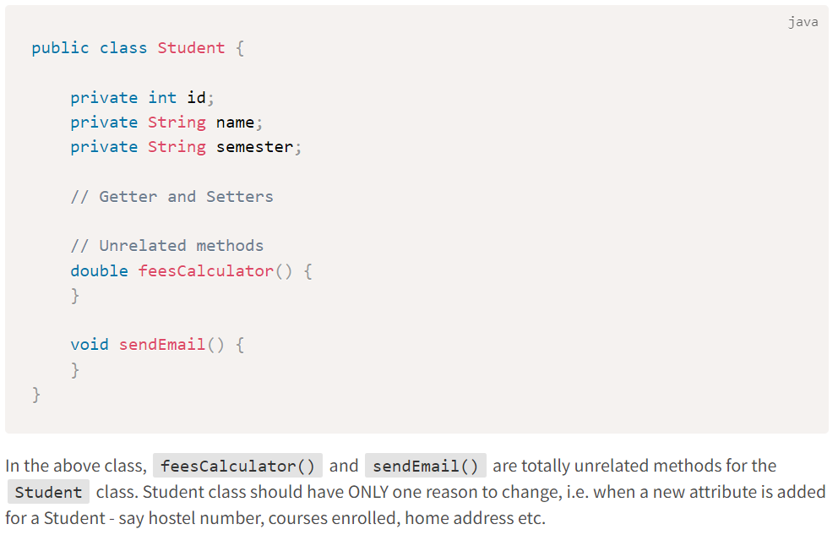
Good Class Organization
SRP - Single Responsibility Principle
Clean Code

Slide 54
Good Class Organization
Cohesion
Cohesion refers to the degree to which elements within a class or a module belong together to fulfill a single, well-defined purpose.
High cohesion means that elements are closely related and focused on a single purpose, while low cohesion means that elements are loosely related and serve multiple purposes.
A cohesive class is:
fields and methods are co-dependent (like getters and setters)
methods that use multiple class fields and other class methods
Thus, we should strive for High Cohesion in classes, packages, modules and whole systems.
Clean Code

Slide 55
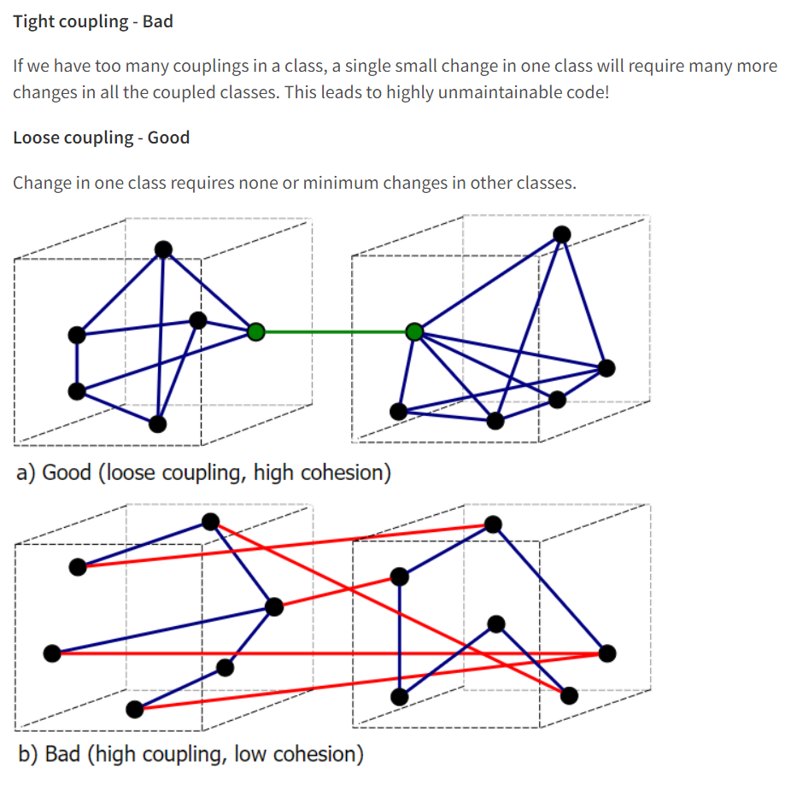
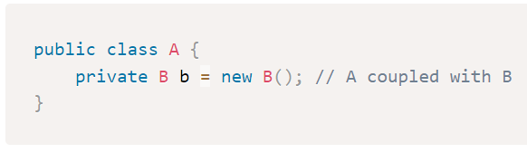
Good Class Organization
Coupling
Coupling refers to the degree of interdependence between software modules or classes, a measure of how interconnected they are.
Clean Code

Slide 56
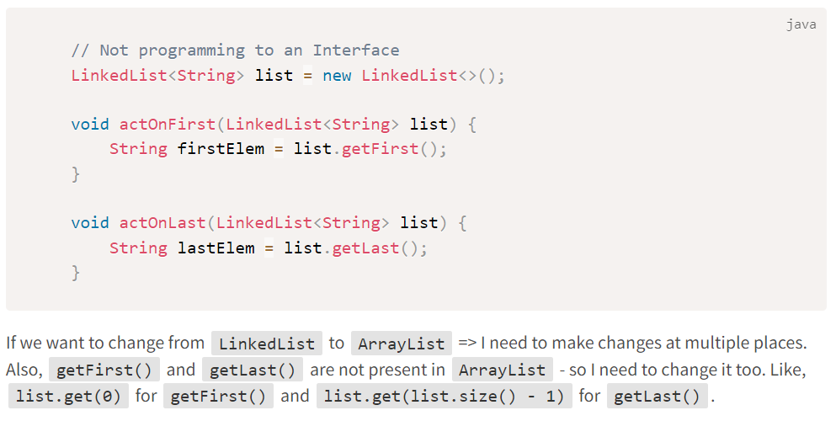
Good Class Organization
Coupling
Thus, to reduce coupling:
follow SRP
increase cohesion
program to an interface
maintain strong encapsulation
use dependency injection
Clean Code

Slide 57
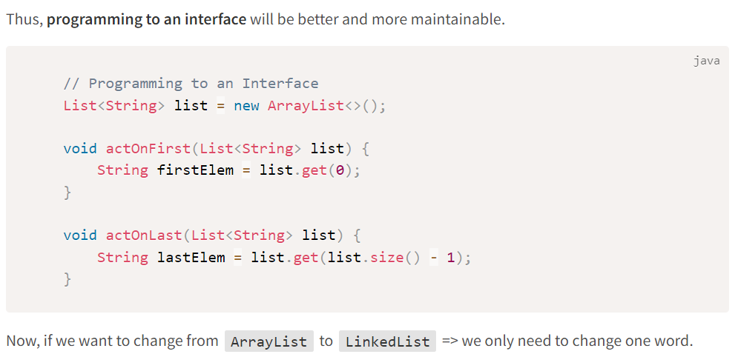
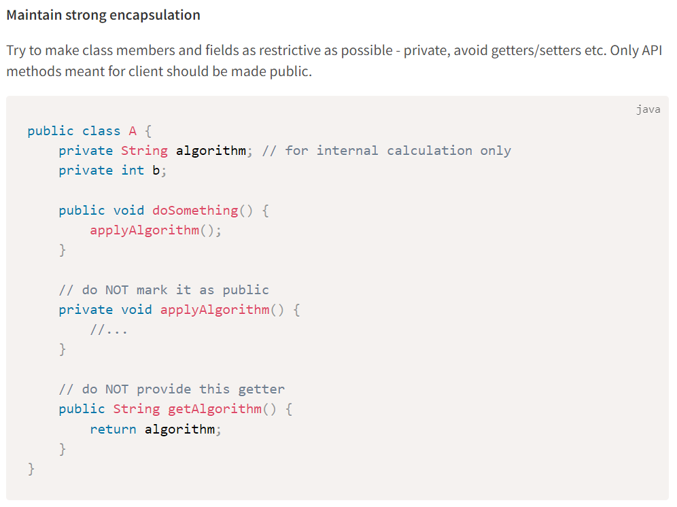
Good Class Organization
Clean Code

Slide 58
Good Names
Good Constructors
Good Methods
Good Exceptions
Good Class Organization
Good Code Style
Good Comments
Maintaining Clean Code

Slide 59
Good Code Style
What is Good Code Style?
Clean code is all about readability and maintainability.
If the whole project or the whole team or the whole company is following certain code style (also called checkstyle in IntelliJ), it would definitely benefit readability.
Almost all the tech-companies today follow a certain code style in its projects.
Various major companies have defined their Java style guide as such:
Google Java Style Guide
Oracle Java Style Guide
Twitter Java Style Guide
Clean Code

Slide 60
Good Names
Good Constructors
Good Methods
Good Exceptions
Good Class Organization
Good Code Style
Good Comments
Maintaining Clean Code

Slide 61
Good Comments
What are Good Comments?
The proper use of comments is to compensate for our failure to express ourselves in code. ~ Robert C. Martin
Clean Code

Slide 62
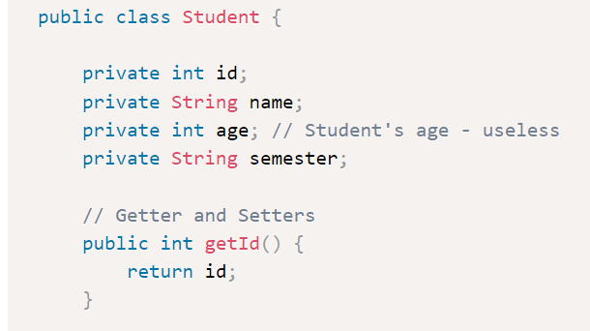
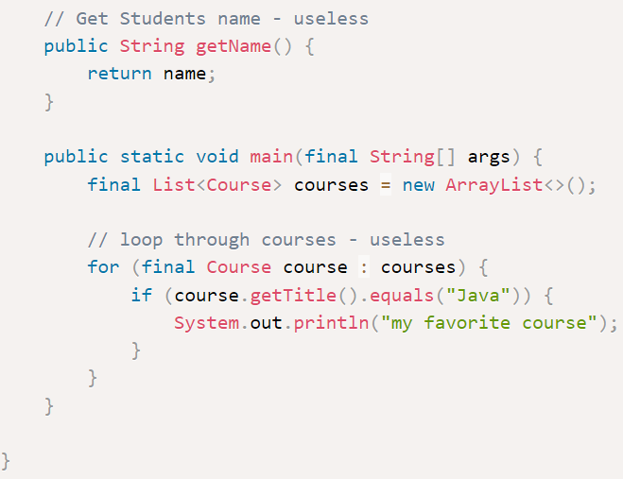
Good Comments
Avoid Useless Comments
Clean Code

Slide 63
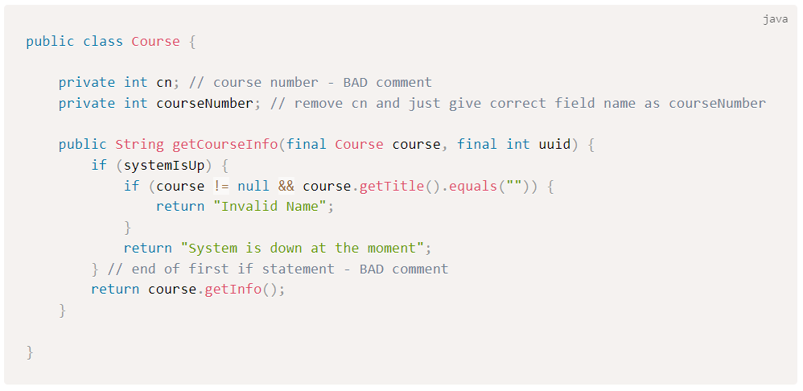
Good Comments
Don’t comment bad code – rewrite it!
Clean Code

Slide 64
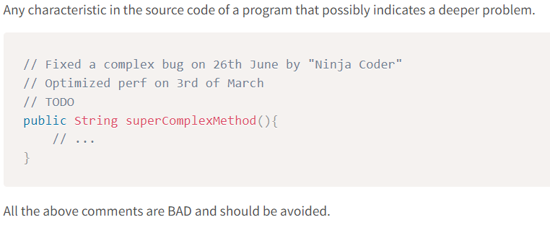
Good Comments
Code Smell
Clean Code

Slide 65
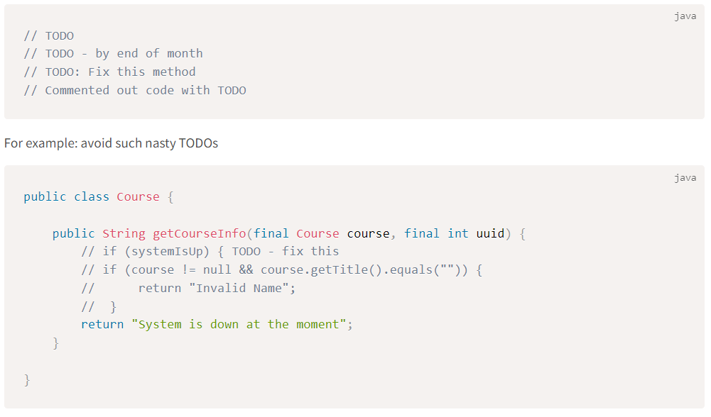
Good Comments
Bad TODOs
Clean Code

Slide 66


Good Comments
These are the Good Comments
Clean Code

Slide 67
Good Names
Good Constructors
Good Methods
Good Exceptions
Good Class Organization
Good Code Style
Good Comments
Maintaining Clean Code

Slide 68
Maintaining Clean Code
How to Maintain Code?
Bad way to maintain code:
Write code and then merge it.
Good way to maintain code:
Define good coding standard or rules -> write code -> static code analysis -> peer code review -> merge
Clean Code

Slide 69
Maintaining Clean Code
Define good coding standard or rules
These can be defined by the senior developers or code gatekeepers or system architects which needs to be adhered to while writing the code.
This includes custom checkstyle as well.
Clean Code

Slide 70

Maintaining Clean Code
Static code analysis
One of the best static code checkers is: SonarLint
SonarLint can be installed as a plugin in IntelliJ, and it can provide all the static code analysis and fixes on fly.
Clean Code

Slide 71
Maintaining Clean Code
Boy Scout Rule
Leave the campground code cleaner than you found it.
It means that if we can find an existing dirty code, and it will take less time to fix it => then fix it.
By doing such incremental fixes, in a long run => it will make the code cleaner and maintainable.
If it takes MORE time to fix it => raise a JIRA and comment it with TODO.
Clean Code

Slide 72
Maintaining Clean Code
Peer code review
At least two reviewers
At least one person understands the business side of the code under review
Merging not possible until all highlighted issues addressed
All the above features are present in GitHub, Bitbucket, etc.
We can also include pair programming for new developers with senior developers in the initial projects.
Clean Code

Slide 73

Summary
Clean Code is about writing code that is easy to understand, read, and maintain.
It involves more than just making the code work—it aims to create efficient and maintainable software.
Good naming conventions are critical for clean code, with names reflecting the purpose of variables, functions, classes, and modules.
Clear names reduce the need for extensive comments and make the code easier to understand.
Good constructors should be clear, concise, and create objects in a consistent state.
Methods should follow the single responsibility principle, making them easier to test and debug.
Exception handling should produce meaningful and actionable exceptions.

Slide 74
Summary
Good exceptions make the code more robust and easier to debug.
Clean code involves well-organized classes following principles like encapsulation and modularity.
Good code style, including consistency in indentation, spacing, and casing, improves code readability.
Comments should be useful, explaining the why rather than the what of the code.
Maintaining clean code requires regular refactoring, rigorous code reviews, and continuous integration.
Clean code practices lead to software that's not just functional, but also efficient, reliable, and easy to maintain.

